Slide 1

HƯỚNG DẪN
THỰC HÀNH HỌC MÁY TRONG Y TẾ
GV : Hoàng Quang Huy
hoangquanghuy@gmail.com

Slide 2
Content
Workflow
Example
Example 1: identify/predict patients with diabetes (classification)
Example 2 : determine/predict the value of a patient's index (regression)

Slide 3
Workflow
Problem definiton Week 2-4
Model Selection Week 8-10
Data collection
Week 2-5
Data preprocessing
Week 5-7
Report/Presentation
Week 14-15
Evaluation
12-13
Model training
Week 10-12

Slide 4
1. Work flow
Step 1: Identify/Define the problem
Classification or regression
Step 2: Data collection
Step 3: Data processing
Step 4 : Model selection
Step 5 : Model Training
Step 6 : Evaluation
Step 7 : Report/Presentation

Slide 5
1. Workflow
Prepare knowledge about Python and Machine Learning (ML)
Learn Python:
+ What is Python?
+ How is Python used in machine learning?
Learn ML : learn on kaggle https://www.kaggle.com/learn/intro-to-machine-learning
+ What is ML?
+ Applying Ml in disease detection problem?

Slide 6
Example
Example 1: identify/predict patients with diabetes (classification)
Example 2 : determine/predict the value of a patient's index (regression)

Slide 7
Example 1
Identify/predict patients with diabetes (classification)
Data preprocessing
Clean data
Classification
KNN
Confusion matrix
Data transformation
Data Reduction
DT
SVM
GaussianNB
Cat Booost
Result
Logistic Regression
Separate data
Test set
Training set
AUC
Feature Selection
Data collection
File csv
Public on kaggle

Slide 8
Step 1 : Identify the problem (problem) and purpose
Determine whether a person has diabetes or not? (have: 1; don't have: 0)
Data : public in Kaggle (csv file)
Link data : https://drive.google.com/file/d/1Itf5rut7v0NI_F28NMta9nG62d0cWdpf/view?usp=sharing
Link code:
https://colab.research.google.com/drive/1jyWWFY8UgKva01vFwZs7bTrR636nIRfw?usp=sharing

Slide 9
Step 2. Dataset collection
Link dataset: https://drive.google.com/file/d/1Itf5rut7v0NI_F28NMta9nG62d0cWdpf/view?usp=sharing
Steps to work with datasets (EDA):
Analyze data in the dataset (size, data characterizes,...)
Convert data types to facilitate processing
https://machinelearningcoban.com/tabml_book/ch_data_processing/eda.html

Slide 10
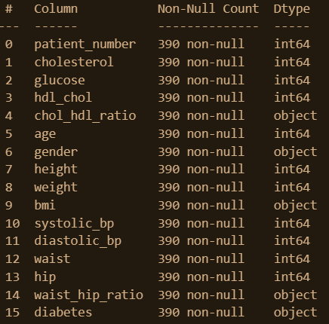
Step 3. Dataset preprocessing
Datasets: 16 columns, 390 datapoints
Normal range of the different blood solutes:
1. Cholestrol - under 200
2. Glucose 80-120(normal)
3. HDL Cholestrol more than 60
4. Systolic BP - 120
5. Distolic BP - 80

Slide 11
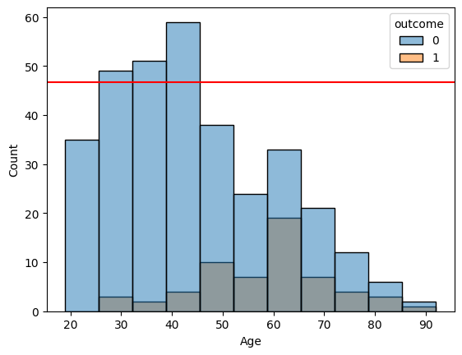
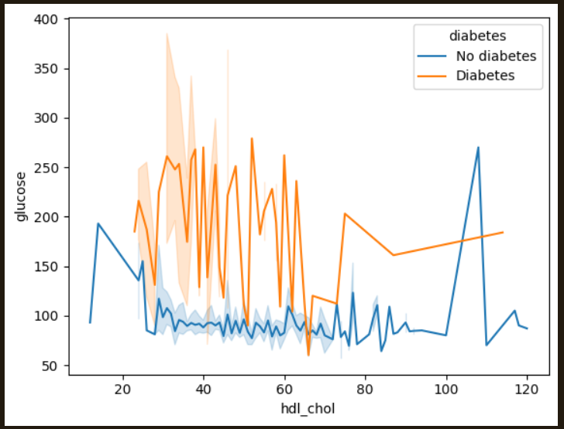
Step 3. Dataset preprocessing –EDA
Average age
No diabetes: 44
Diabetes: 58
-> The incidence of diabetes increases from the age of 58
Cholesterol
Diabetic patients have lower HDL-Cholesterol

Slide 12
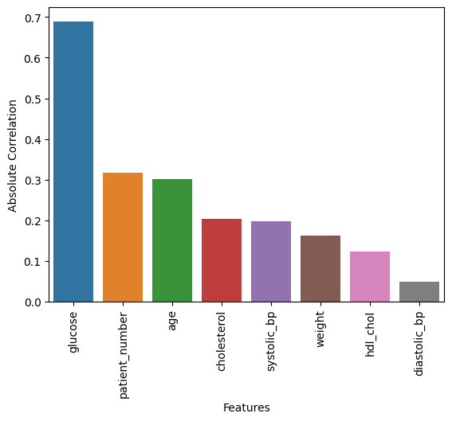
Step 3. Dataset preprocessing - EDA
compare correlation between a target and other features in absolute
-> train the model on the most important features

Slide 13
Step 3. Dataset preprocessing
Divide data : training set and test set

Slide 14
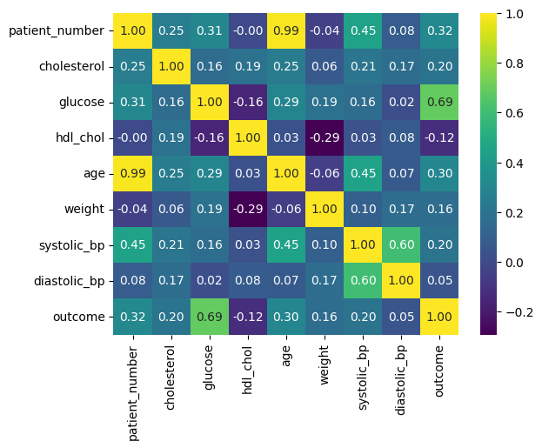
Step 3. Dataset preprocessing - EDA
visualizing the correlation by heatmap
removing the fields which are not that important

Slide 15
Step 4. Model selection
LR
DT
KNN
SVM
Gaussian Naie Bayes
Catboot
Model Training | Accuracy
Logistic Regression (LR) | 0.90
Decision Tree (DT) | 0.90
K-Nearest Neighbor (KNN) | 0.92
Support Vectro Machine (SVM) | 0.92
Gaussian Naïve Bayes | 0.91
CatBoost | 0.91

Slide 16
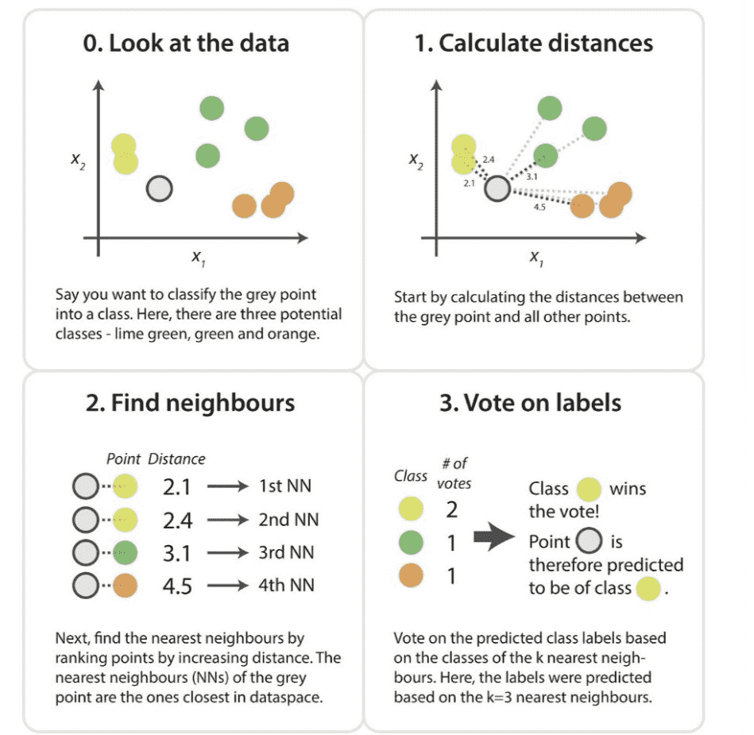
Step 4. Model selection
KNN
Advantages:
• It is very simple to implement
• It acts robustly to the noisy training data
• It is more effective if the training data is large
Disadvantages:
• The value of K needs to be determined every time and it can be sometimes complex
• For every training sample, the distance between every data point is calculated and it increases the computational cost.

Slide 17

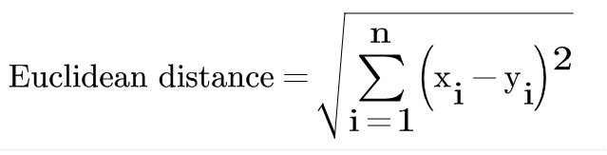
Step 4. Model selection
K nearest neighbors
K-nearest neighbors (KNN) is a machine learning algorithm used for both classification and regression tasks. It is a type of instance-based learning, also known as lazy learning, where the algorithm memorizes the entire training dataset rather than constructing a model.

Slide 18
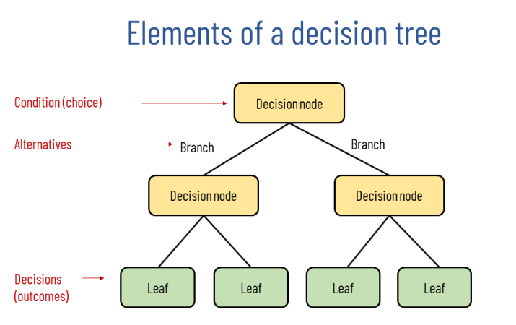
Step 4. Model selection
A decision tree is a predictive modeling tool that is commonly used in machine learning and data mining. It is a flowchart-like structure where each internal node represents a feature or attribute, each branch represents a decision rule, and each leaf node represents the outcome or prediction.

Slide 19
Step 4. Model selection
Decision Tree
Advantages:
Less effort for data preparation during pre-processing.
Not require normalization of data.
Not require scaling of data as well.
Missing values in the data also do NOT affect the process of building a decision tree to any considerable extent.
Very intuitive and easy to explain to technical teams as well as stakeholders.
Disadvantage:
Instability.
Complex compared to other algorithms.
Higher time to train the model.
Algorithm is inadequate for applying regression and predicting continuous values.

Slide 20
Step 5. Model training
Results: SVM and LR has highest accurary in comparison with orthers
Model Training | Accuracy
K-Nearest Neighbor | 0.959
SVM | 0.969
Decision Tree (DT) | 0.898
Logistic Regression (LR) | 0.969
Gaussian Naïve Bayes | 0.938
CatBoost | 0.959

Slide 21
Step 5 Code and test
Create a folder containing data
Upload the data file to the created folder
Link the code to the drive
from google.colab import drive
drive.mount('/content/drive’)
Create path to data
Ex: path = '/content/drive/MyDrive/Data/diabetes2.csv’
Change Runtime to “GPU”
Press Run all and check the result

Slide 22
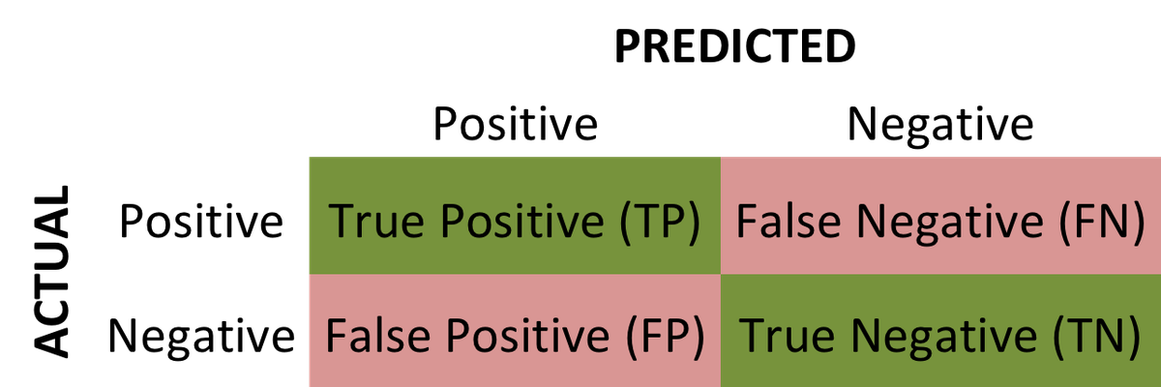
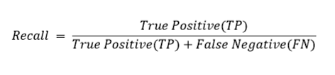
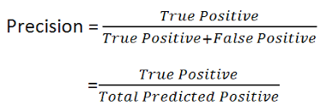
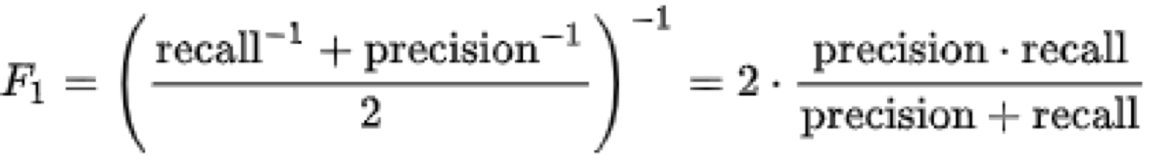
Step 6 Evaluation
Notes:
Recall is a measure of the completeness or comprehensiveness of a system's output. Recall is often used in information retrieval tasks, such as search engines, where the goal is to retrieve all the relevant documents or information related to a query.
Precision is a measure of the exactness or accuracy of a system's output. Precision is commonly used in conjunction with recall to evaluate the performance of systems comprehensively.
The F1 score is a metric that combines precision and recall into a single value, providing a balanced measure of a system's performance. It is particularly useful when there is an uneven class distribution or when both precision and recall are equally important.

Slide 23
Step 6 Evaluation
model: KNeighborsClassifier()
Accuracy: 0.959
Precision: 0.875
Recall: 0.7
F1 Score: 0.778
AUC-ROC: 0.844
Confusion Matrix:
[[87 1]
[ 3 7]]
model:
SVM
Accuracy: 0.969
Precision: 0.889
Recall: 0.8
F1 Score: 0.842
AUC-ROC: 0.894
Confusion Matrix:
[[87 1]
[ 2 8]]

Slide 24
Step 6 Evaluation
Performances of model are shown in the table below, DT (class 1) has bad performance
Model | Results | F1 score | Recall | Precision
KNN | 0 | 0.98 | 0.99 | 0.97
 | 1 | 0.78 | 0.70 | 0.88
DT | 0 | 0.95 | 1.00 | 0.90
 | 1 | 0.00 | 0.00 | 0.00
Logistic Regression | 0 | 0.98 | 0.99 | 0.98
 | 1 | 0.84 | 0.80 | 0.89
Gaussian NB | 0 | 0.97 | 0.97 | 0.97
 | 1 | 0.70 | 0.70 | 0.70
RF | 0 | 0.97 | 0.98 | 0.97
 | 1 | 0.74 | 0.70 | 0.78

Slide 25
Question
1. Train and evaluate with fewer features
Kiểm tra xem mô hình có hoạt động tốt hơn khi giảm số chiều dữ liệu đầu vào (giảm nhiễu, tránh overfitting).
Gợi ý :
Sử dụng feature selection (chọn các đặc trưng quan trọng).
Đánh giá lại từng mô hình sau khi loại bỏ những đặc trưng ít ảnh hưởng.
Đặc biệt hữu ích cho mô hình Decision Tree (DT), vì DT có thể dễ bị overfit khi có quá nhiều đặc trưng.
2. Train and evaluate with fewer data
Đánh giá độ robust (khả năng chống chịu) của mô hình khi dữ liệu bị hạn chế.
Gợi ý hành động:
Lấy một phần nhỏ hơn của tập dữ liệu (ví dụ: 50%).
Huấn luyện và đánh giá lại mô hình.
Theo bảng, mô hình DT cho class 1 có F1 = 0.0 → kiểm tra xem việc giảm dữ liệu có cải thiện được tình trạng này hay không (tránh học thuộc class 0).

Slide 26
Question
3. Train and evaluate with different dataset
Kiểm tra tính tổng quát hóa của mô hình (generalization).
Gợi ý :
Áp dụng mô hình hiện tại trên một tập dữ liệu khác (có thể đến từ môi trường khác, dữ liệu thực tế...).
So sánh hiệu năng của các mô hình với các chỉ số F1/Recall/Precision trên tập mới.
Đây là bài kiểm tra cần thiết nếu bạn phát hiện mô hình có độ chính xác cao nhưng overfit dữ liệu gốc (như DT ở class 0 nhưng fail hoàn toàn ở class 1).
Chú ý :
Mô hình DT cần cải thiện nghiêm trọng ở class 1 (F1 = 0.0, Recall = 0.0).
Có thể thử lại DT với:
Feature selection
Regularization (pruning)
Tập dữ liệu cân bằng hơn
Các mô hình như Logistic Regression, KNN đang hoạt động khá tốt cho cả hai lớp → có thể dùng làm baseline để so sánh sau khi áp dụng các thay đổi.

Slide 27
References
Classification and Diagnosis of Diabetes, https://www.ncbi.nlm.nih.gov/books/NBK568014/
Soni, Diabetes Prediction using Machine Learning Techniques, IJERT, ISSN: 2278-0181 IJERTV9IS090496 ,www.ijert.org Vol. 9 Issue 09, September-2020
Joshi, T. N., Diabetes prediction using machine learning techniques,
Ijera, 8(1), 9-13, 2018.

